Slide 1
UNIX/Linux
Development Environment
Haiyong Zheng
http://vision.ouc.edu.cn/~zhenghaiyong

Slide 2
Contents
UNIX/Linux Shell
Programming Language
Development Environment

Slide 3
Contents
UNIX/Linux Shell
Programming Language
Development Environment

Slide 4
Shell
/etc/
login shell vs. non-login shell
……

Slide 5
Package Management System
dpkg: apt, aptitude, …
RPM: yum, apt-rpm, …
tar-ball: slackpkg, slapt-get, …
TeX => CTAN
Emacs => ELPA
Python => PyPI => easy_install => pip
Perl => CPAN => cpan

Slide 6
HowTo Install Softwares
Package Management System
Source Code

Slide 7
HowTo DeBug
from Source
Compiler Theory
Know more about
./configure && make && make install
programming language

Slide 8
Contents
UNIX/Linux Shell
Programming Language
Development Environment

Slide 9
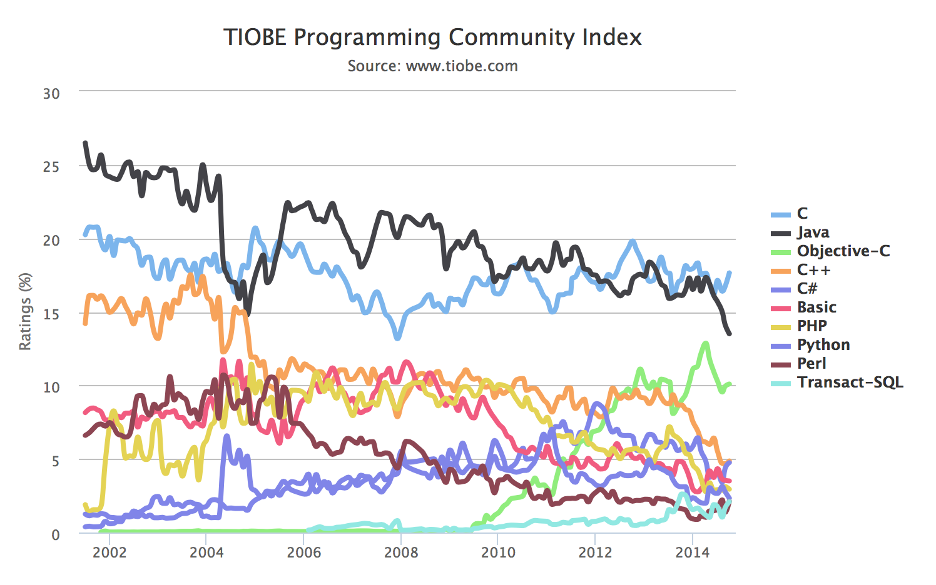
TIOBE Index

Slide 10
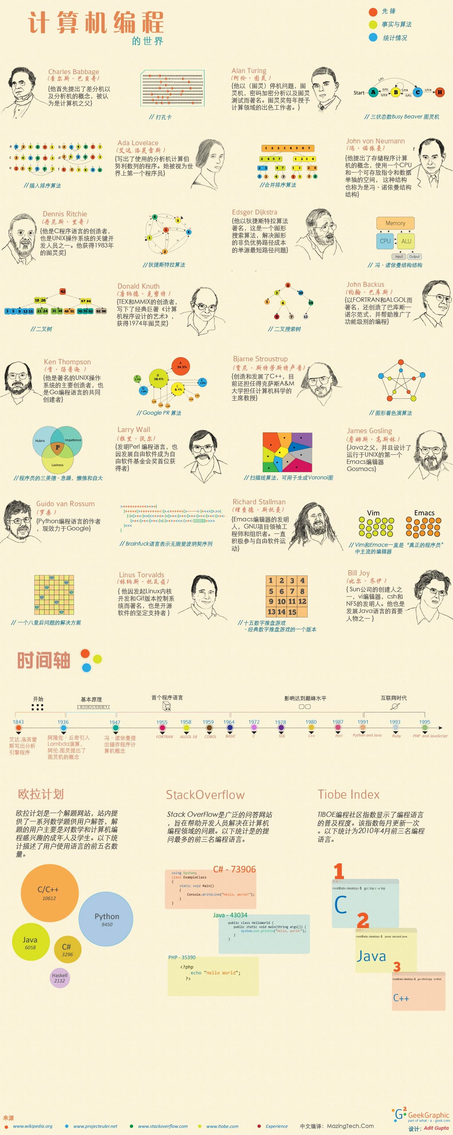
The World of Programming

Slide 11
Contents
UNIX/Linux Shell
Programming Language
Development Environment

Slide 12
Compilers
gcc, g++, …
Intel C/C++ Compilers
Mac OS X LLVM Compiler
……

Slide 13
Development Tools
make / cmake / imake
gdb

Slide 14
IDE
Eclipse
Code::Blocks
vim
Emacs
……

Slide 15
MORE
VCS: git, svn, …
O|B|F: Open Bioinformatics Foundation
LAMP: Linux+Apache+Mysql+PHP/Perl/Python
http://www.yolinux.com/TUTORIALS/LinuxTutorialSoftwareDevelopment.html

